Slide 1
Classes and OOP
Module 13

Slide 2
Class Intro

Slide 3
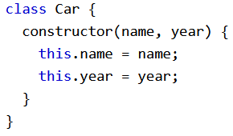
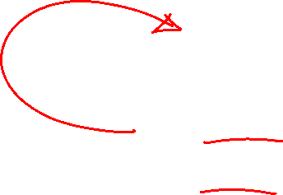
JS Class Syntax
We can create classes using the class keyword
Every class must have a method called constructor(), which is used to created new objects from that class
Classes are templates for JS objects, not objects themselves

Slide 4

Using a Class
Once you have created a class, you can use it to create objects of that type
A class can create an unlimited number of objects
The constructor method gets called automatically when you create an object

Slide 5
The constructor Method
constructor method is a special method
It must have the exact name “constructor”
It runs automatically when a new object is created

Slide 6
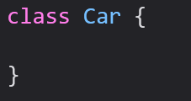
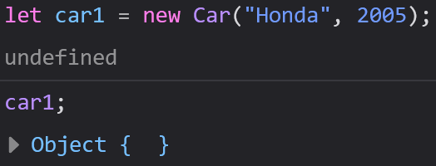
The constructor Method
We use the constructor method to initialize object properties
If you do not write a constructor method, JavaScript will add an empty constructor method
The empty constructor method will create an object with no properties or values

Slide 7
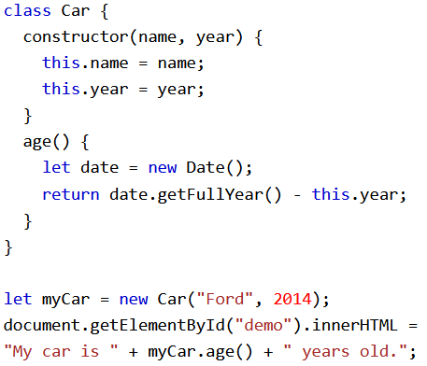
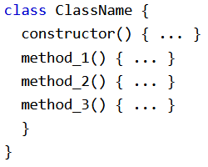
Class Methods
Class methods are created with a similar syntax to object methods
After you create the class and the constructor method you can create as many methods as you would like

Slide 8
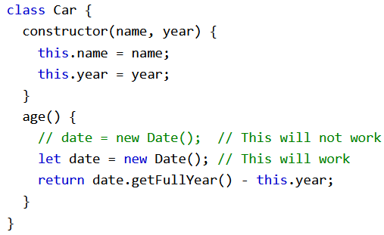
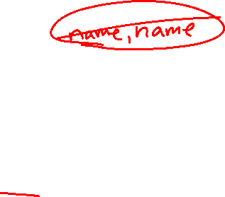
“use strict”
The syntax in classes must be written in “strict mode”
You will get an error if you do not follow the “strict mode” rules

Slide 9
Class Inheritance

Slide 10
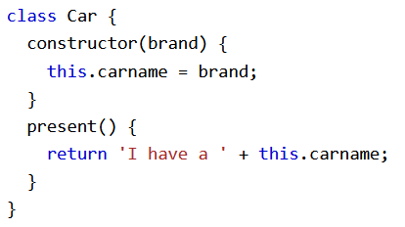
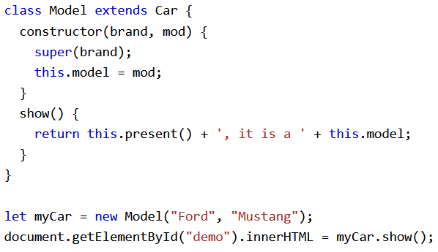

Class Inheritance
To create a class inheritance, use the extends keyword
A class created with a class inheritance inherits all the methods from another class

Slide 11
Class Inheritance
The super() method refers to the parent class
When we call super() in the constructor method, we call the parent’s constructor method and gets access to the parent’s properties and methods

Slide 12

Class Inheritance
Inheritance is useful for code reusability: reuse properties and methods of an existing class when you create a new class

Slide 13
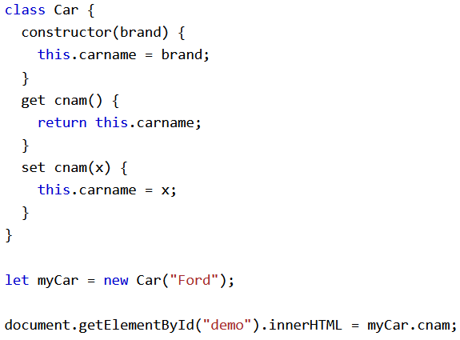
Getters and Setters
Classes also allow you to use getters and setters
It can be smart to use getters and setters for your properties, especially if you want to do something special with the value before returning them, or before you set them
To add getters and setters, use the get and set keywords

Slide 14
Getters and Setters
Even if the getter is a method, you do not need to use parentheses when you want to get the property value
The name of the getter/setter method can’t be the same as the name of the property
Many programmers use an underscore character before the property name to separate the getter/setter from the actual property

Slide 15
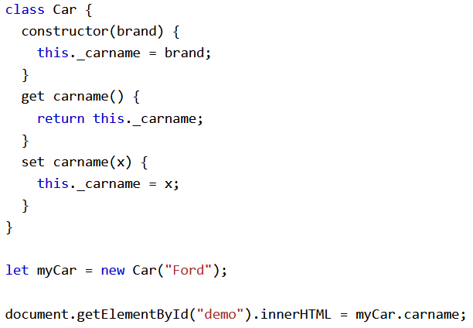
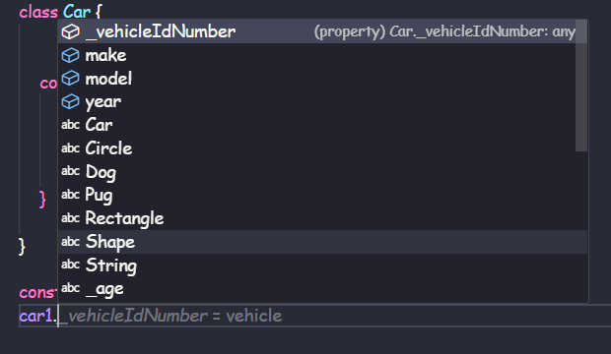
Getters and Setters
When you create a property name that begins with an underscore, it is intended to be a private property
Private properties are only intended to be used by methods within the class, but not accessible from outside of the class
Naming private properties beginning with an underscore is only a naming convention and will not enforce this

Slide 16
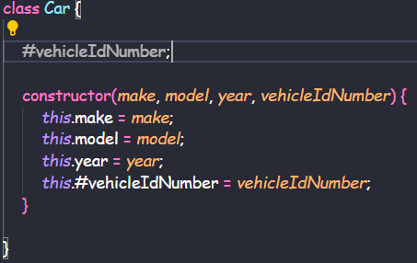
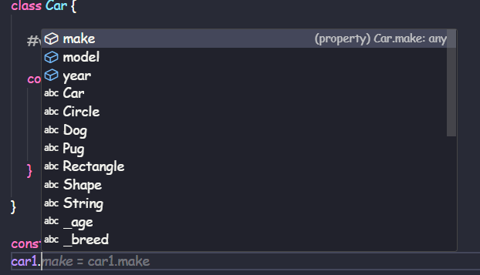

Access Modifiers
We can create truly private variables by naming them beginning with a hashtag #
We need to include the variable inside the instructor, and in between the class keyword and the constructor

Slide 17
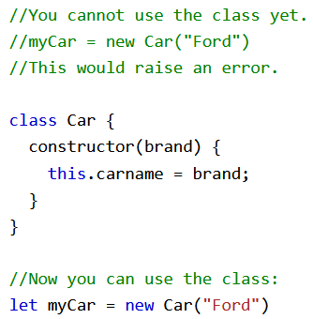
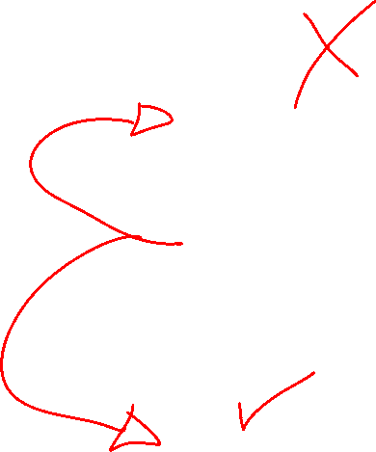
Hoisting
Unlike much of JavaScript, classes do not get hoisted
This means you must declare your class before you use it

Slide 18
Class Static

Slide 19
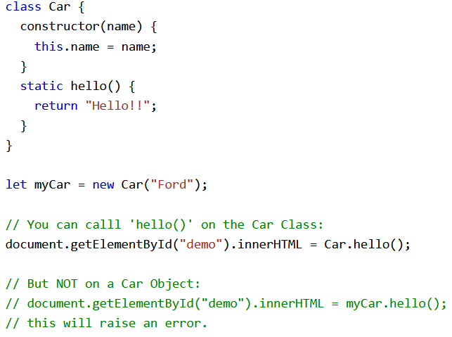

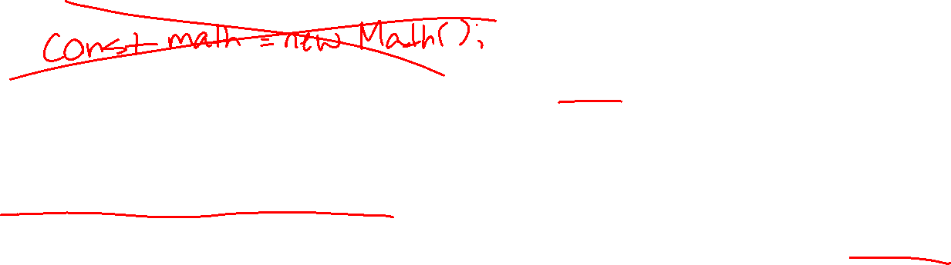
Class Static Methods
A static method is defined on the class itself
static methods cannot be called on individual objects, only off classes

